Slide 1
Autonomous Driving In a Crowded City
Tarik Isildar

Slide 2
Imitation Learning

Slide 3
Method
It’s good to use all the possible inputs and outputs and hopefully it’ll work like a magic box since it’s end-to-end
But it comes with its own problems. Data-size, bias etc.
Instead I treated every input differently (Throttle, steering angle and brake in our case).
Throttle: Solely rule-based. Trying to keep the vehicle at a certain speed if it’s not braking.
Steering angle: End-to-End DNN training with own dataset and parameters.
Brake: End-to-End DNN training with own dataset and parameters.

Slide 4
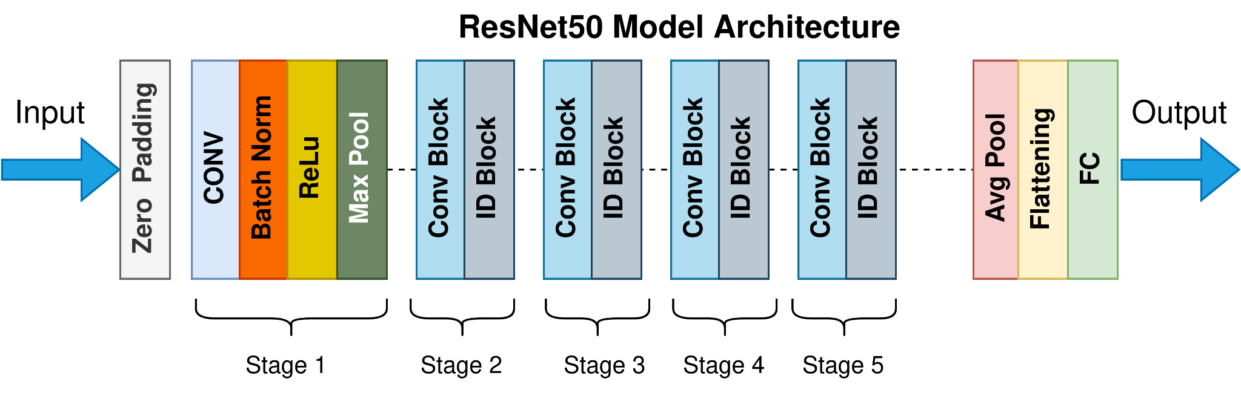
The Network
Used a ResNet50 architecture with a pre-trained backbone. (PyTorch)

Slide 5
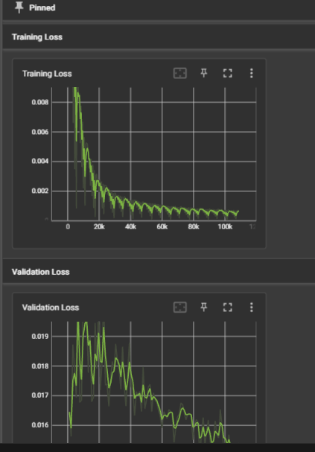
The Data and Training
From the training mode in the simulator I gathered recording footage from all possible scenarios (that I could think of). I had around 20 thousand images that I used as base data And I ran a couple of training on it.
Graphs seem well-ish behaved

Slide 6


Slide 7
How to Improve

Slide 8
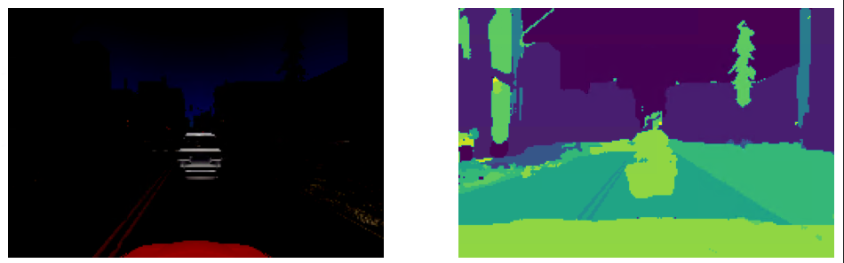
Image Segmentation
UNet architecture to mask the needed objects and use this data in end-to-end.
Lack of mask data for my need and problems with the performance
Discarded.

Slide 9

Object Detection
Pre-trained YoloV5 to detect the other cars and have a rule-based braking mechanism.
Not ideal. Good as a backup brake to prevent crashes but in the real world it would be better to rely on the sensor information for that.

Slide 10
The Data Fine Tuning

Slide 11
The Data Fine Tuning
When watching the test runs, I can still give input and correct the behavior.
Those corrected behaviors are the data I need the most. Because they’re where the model performs poorly.
I added some extensions on the drive script to support data recording.
So it records the coming data and manipulated input whenever the user intervenes the test.
And train less epochs / smaller learning rates on the best performing model we have.

